Slide 1
Recitation 4
Comp 401-002

Slide 2
Casting
Casting reinterprets a variable as a different type.
For example, remember that a double is a decimal, and an integer is not.
When you divide an integer by an integer, you get an integer.
However, we can tell Java to treat one of the integers as a double, in which case the entire result will be a double
Tells Java, “right now, treat x as a double”

Slide 3
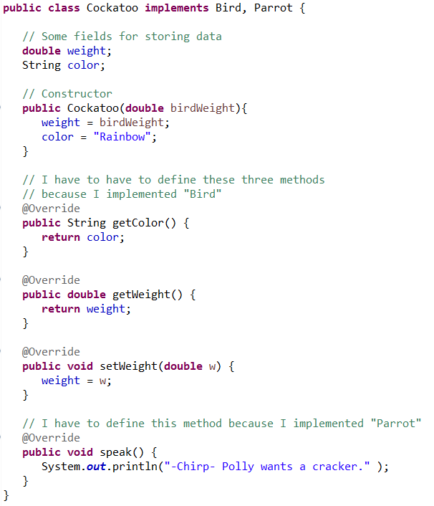
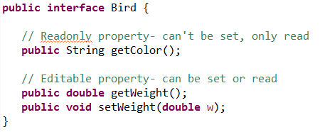
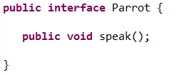
Interfaces example

Slide 4
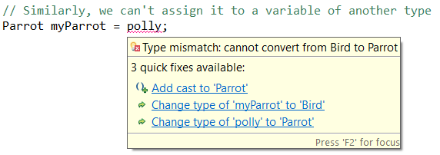
Casting objects

Slide 5
In Assignment 3
Every token class will implement at least one interface (the generic token interface)
Some token classes will implement additional interfaces
You will always use variables through interface variables, not class variables.

Slide 6
Recitation assignment
Use the recitation link on the course website to find today’s assignment.
Look at the instructions and experiment with the ObjectEditor.
On Sakai, submit a screenshot that shows the results of some of your experimentation (we should see that you got the program to run and changed a few things).
Some of the instructions are outdated. In particular, on the last slide:
Point 1: line numbers are 8 and 9
Point 2: line number is 13
Point 3: Try different values as the argument to the sleep() method, and modify only the numeric argument of moveShapes.
Point 4: No need to try to refactor to AStringShape, but try doing it to Rectangle. The point is trying to show that if you do not tag a class as a particular shape, ObjectEditor will try to infer it from the name.
Miscellaneous: As in the praxes, try uncommenting different lines to see what is happening

